Slide 1

Succession Planning
Webinar Series
Webinar #3
Crisis readiness: Emergency Succession Planning in Action

Slide 2
Introductions…
  Donna Stelling-Gurnett
  VP, Association Management Services
  Hinman Straub, PC
  121 State Street
  Albany, NY 12207
  Email: Dgurnett@hinmanstraub.com
Chyresse Wells, APR
Vice President
Corning Place Communications
121 State Street
Albany, NY 12207
Email: Cwells@corningplace.com

Slide 3
Housekeeping items…
Yes – this webinar (and the entire webinar series) is being recorded and will be made available to NPCNYC members!
I would love engagement during this webinar! Feel free to use the chat function, the Q&A box or raise your hand and we will unmute you so you can ask your question or offer your thoughts and feedback.

Slide 4
Goals for today:
Why succession planning is critical.
What is emergency succession planning?
The importance of communication…
Core components of an emergency succession plan.

Slide 5
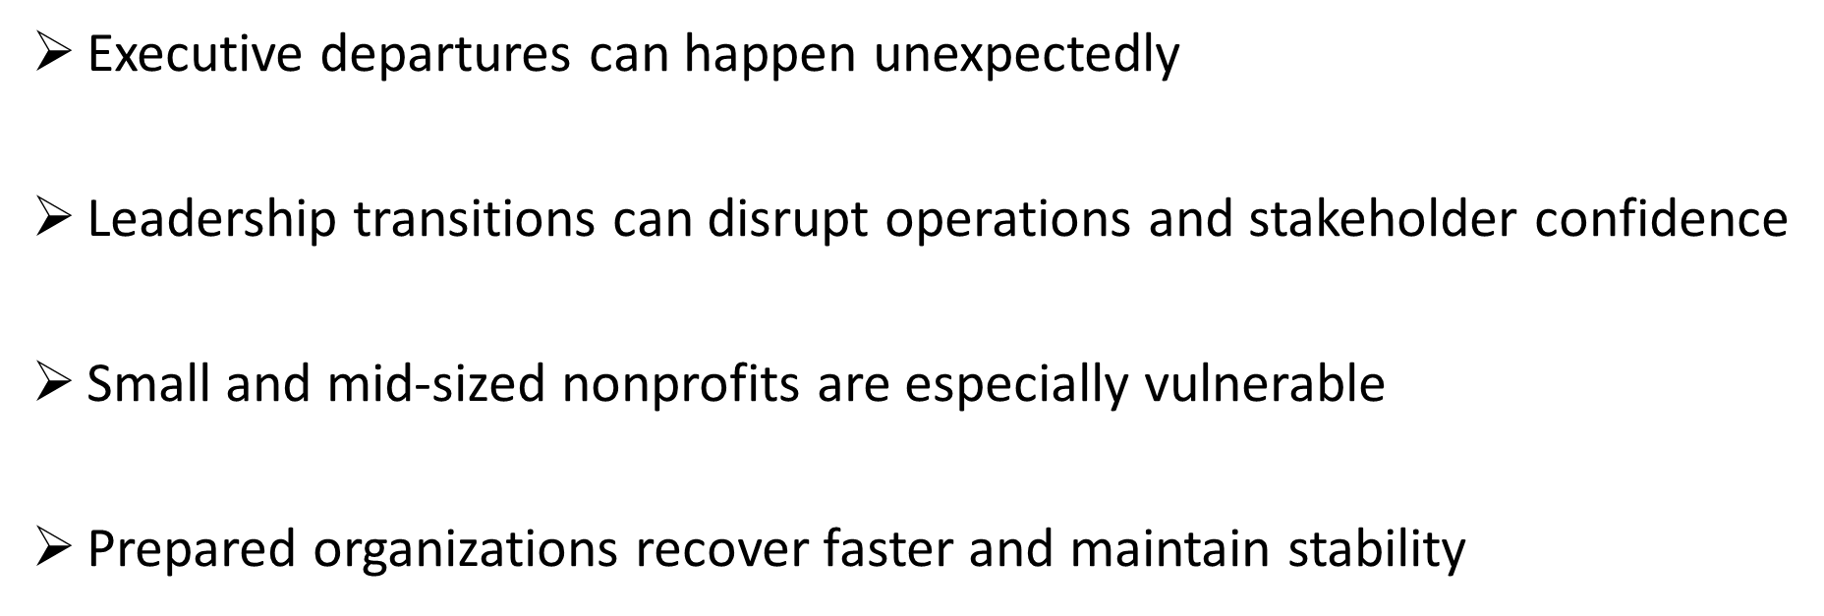
Why Succession Planning Matters…

Slide 6
Emergency vs. Planned Transitions
Emergency (Unexpected) Departure
Focus: Continuity
Timeframe: Immediate to 3 months
Requires:
Interim leadership assignment
Quick access to accounts & records
Communication to staff, board, partners
Stabilization of operations
Planned (6+ Months Notice)
Focus: Optimization
Timeframe: 6 months – 1 year
Allows for:
Recruitment & onboarding overlap
Mentoring & gradual handoff
Strategic review of position & structure
Stakeholder relationship introductions

Slide 7
What is Emergency Succession Planning?
Emergency succession planning is a short-term operational continuity strategy that ensures leadership and critical functions continue during an unexpected transition.
Emergency Succession:
Immediate continuity
Crisis response
Temporary leadership structure
Focus on operational stability

Slide 8
Risks of not having a plan…
Staff confusion and low morale
Interrupted operations and delayed decision-making
Grant and compliance risks
Loss of stakeholder confidence
Financial instability and reputational concerns
Disruptions to community services and programs

Slide 9
Core components of an emergency succession plan
Leadership Structure
Immediate Response Protocols
Operational Continuity
Communications Plan
Board Responsibilities
Documentation & Access

Slide 10
Immediate response protocols
First 24 – 72 hours:
  Notify Board Chair
  Activate succession plan
  Designate interim leadership
  Secure systems and access
  Communicate with staff
  Review immediate deadlines and obligations

Slide 11
Identifying critical functions
What functions must continue immediately?
Payroll and financial approvals
Grant reporting and compliance
Client and community services
Vendor and partner communications
Board coordination
Human resources oversight

Slide 12
Interim leadership structures
Common Interim Leadership Models:
  Internal Interim Executive
  Shared Leadership Team
  Board-Led Oversight
  External Interim Consultant
Interim roles should be identified BEFORE a crisis occurs.

Slide 13
Protecting institutional knowledge
Critical information should be centralized and accessible:
  Passwords and system access
  Grant calendars and reporting deadlines
  Contracts and vendor contacts
  Financial records
  HR documentation
  Board policies and governance materials

Slide 14
The board’s role during a crisis
Board Responsibilities:
  Activate the succession plan
  Support interim leadership
  Ensure operational continuity
  Maintain stakeholder confidence
  Avoid operational micromanagement
  Begin long-term transition planning if necessary
The board governs through the crisis— it should not become the crisis.

Slide 15
Crisis Communication Plan
Effective crisis management is preparation.
Critical components of a CCP include:
  Crisis Communication Team: Identify key personnel responsible for managing communication.
  Stakeholder Map: Understand who needs to receive communication, when (sequence), and how—board directors, staff, community partners, media, and local authorities.
  Message Templates: Develop pre-approved templates for various scenarios to speed up response times while ensuring consistency and clarity.
  Communication Channels: Ensure redundancy by utilizing multiple channels (personal email, e-newsletter, SMS, websites, and social media) to reach stakeholders effectively.

Slide 16
Communication during crisis
When a crisis occurs, organizations should follow core principles to ensure communication is timely and effective:
  Speed: The first few hours of a crisis are critical. Delayed responses can lead to misinformation and erode trust.
  Accuracy: Credibility and trust are essential.
  Clarity: Avoid jargon or overly technical language. Stakeholders need clear, concise, and actionable messages.
  Consistency: Mixed messages create confusion. Sticking with one trained spokesperson, when possible, will also provide consistency in messaging.
  Empathy: Acknowledge the emotional impact of the crisis (which can vary).

Slide 17
Post crisis communication
Once the immediate situation has passed, post-crisis communication is just as important to ensure normalcy and a path forward.
It is important to:
  Provide Updates: Let stakeholders know what has been resolved, what remains ongoing, and any long-term changes.
  Evaluate: Assess the communication process—what worked, what didn’t, and what needs to change in future planning.
  Show Appreciation: Recognize the efforts of staff, partners, and the community. Gratitude boosts morale and strengthens relationships. This is very important.
  Document and Archive: Keep detailed records of all communications for legal, compliance, and training purposes.

Slide 18
Key takeaways
Emergency succession planning is about:
  Stability
  Continuity
  Preparedness
  Protecting organizational mission
  Maintaining stakeholder confidence
The best crisis plans are developed before they are ever needed.

Slide 19
Emergency succession planning checklist
Does Your Organization Have:
Interim leadership identified
Updated contact lists
Board emergency procedures
Communication templates
Access to critical systems
Delegated authority documentation
Cross-trained staff
Secure file storage
Annual plan review process

Slide 20
Open Discussion
What would be the biggest operational challenge your organization would face during an unexpected leadership transition?

Slide 21

Questions…

Slide 22
Thursday, May 21st
Sustaining Leadership: Long-Term Succession and Talent Development
  Effective succession planning goes beyond contingency planning. This session addresses long-term strategies for identifying and developing future leaders, strengthening internal talent pipelines, and embedding succession planning into organizational culture and strategic planning processes.

Slide 23
Introductions…
  Donna Stelling-Gurnett
  VP, Association Management Services
  Hinman Straub, PC
  121 State Street
  Albany, NY 12207
  Email: Dgurnett@hinmanstraub.com
Chyresse Wells, APR
Vice President
Corning Place Communications
121 State Street
Albany, NY 12207
Email: Cwells@corningplace.com

